Slide 1

CSS
TOPICS, QuizZES & EXPERIMENTS
Foundations of Web Front-end

Slide 2
Quiz 1
Various Ways of Applying Styles

Slide 3
CSS Basics - VARIOUS WAYS OF APPLYING STYLES
What are the 3 ways to include styles for an element?
Which method of applying styles is preferred in each of these cases?
Styles that are to be applied across many pages in a web site
Styles restricted to the elements on one page of a web site

Slide 4

Experiment - 1
Various Ways of Applying Styles

Slide 5
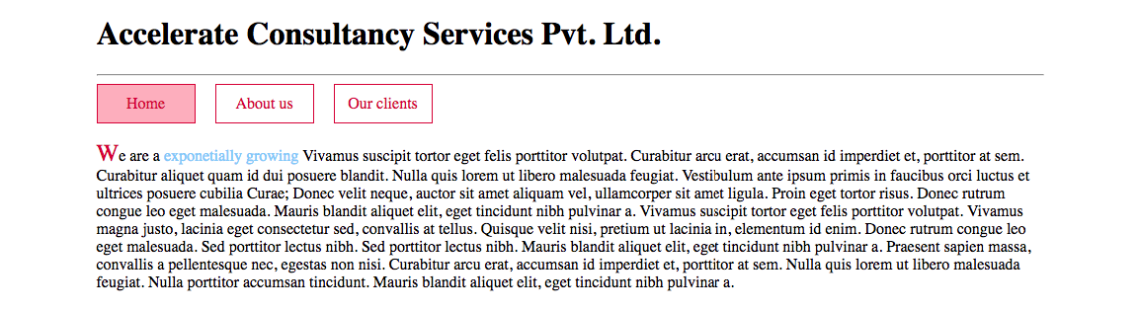
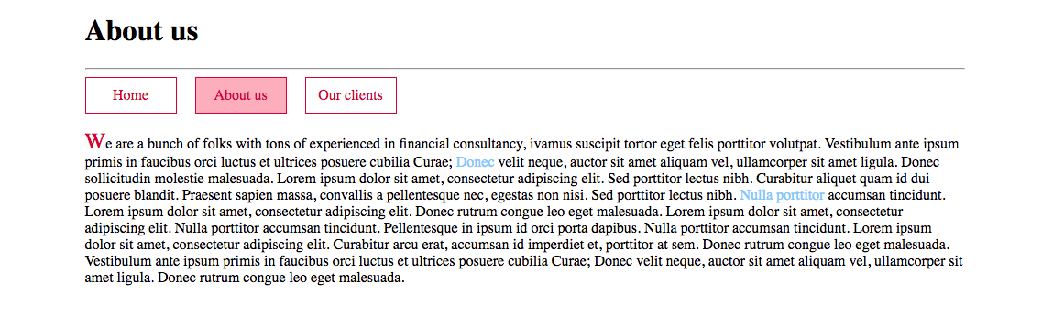
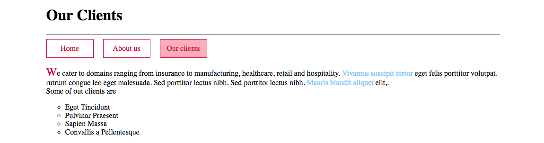
CSS BASICS - VARIOUS WAYS OF APPLYING STYLES

Slide 6
CSS Basics - VARIOUS WAYS OF APPLYING STYLES
Develop the mini web site consisting of 3 pages - Home, About us and Our Clients.
The links, navigation menu and first letter should be styled uniformly across the site as shown.
Navigation menu is to be constructed using a <ul> (and <li>s within it)
The list of clients should be displayed with circle bullets.
The menu link for the current page is highlighted in pink. Same background is to be used on hover over the links too.

Slide 7
Quiz 2
CSS Selectors

Slide 8
CSS BASICS - SELECTORS
Form the selectors we would use in the following situations.
Style all paragraphs
Style all elements with class gallery-item that lie right within an element with class gallery
Style all elements with class gallery-img that lie deep within an element with class gallery
Style all password input elements
Style all spans with class product-name that lie within some div with class product
Style the last child of any kind of list
Style all elements on the page

Slide 9
CSS BASICS - SELECTORS
Describe what these selectors select
p.intro > a[href=“https://www.google.com“]
a.btn.btn-primay
.highlighted:first-line
#primary-menu > li:hover a, #sub-menu > li:hover
#primary-menu > li:hover > #sub-menu

Slide 10
Experiment - 2
Selectors

Slide 11
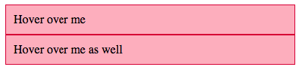
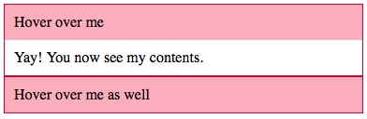
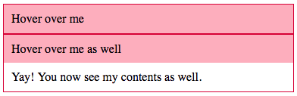
CSS BASICS - SELECTORS
Design a collapsible panel as shown. A panel has a heading (in pink) and a body.
The body of each panel is hidden by default. It shows up when the corresponding heading is hovered upon.
Make sure to apply appropriate border, padding, background colour etc.
Refer: https://developer.mozilla.org/en-US/docs/Web/CSS/Adjacent_sibling_selectors

Slide 12
Quiz 3
Inheritance, Specificity and
Cascade

Slide 13
CSS BASICS - INHERITANCE, SPECIFICITY AND CASCADE
Which of these is inherited by child elements from parent?
color, border, font-size, padding, display, background-color (last one is tricky)
How can we inherit border property’s value from the parent?
We would like to display ‘Hello’ in the default text color instead of red. How can this be done? <p style=“color: red;”> <span ______=“_____:_______”>Hello</span> </p>

Slide 14
CSS BASICS - INHERITANCE, SPECIFICITY AND CASCADE
We have a span like so in our page. What is the color of the span in each case? <span id=“my-span” class=“red”>Hello</span> a) <style> span { color: blue; } span { color: green; } </style> b) <style> .red { color: red; } span { color: blue; } span { color: green; } </style> c) <style> #my-span { color: gray; } .red { color: red; } span { color: blue; } span { color: green; } </style>
Repeat the previous exercise when the span is defined as below instead. <span id=“my-span” class=“red” style=“color: purple;”>Hello</span>

Slide 15
CSS BASICS - INHERITANCE, SPECIFICITY AND CASCADE
What is the specificity value for selectors in each of these cases? Which one will win in case of a CSS property conflict (for elements that match both selectors)? Assume order of selectors on the page is as shown below. a) .gallery > .gallery-item ul.gallery > li b) p > a.btn.btn-primary p.cta >a.btn-primary c) .introduction-section #buy-button #introduction-section > .btn-primary

Slide 16
Experiment - 3
Inheritance, Specificity and Cascade

Slide 17
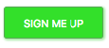
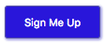
CSS BASICS - INHERITANCE, SPECIFICITY AND CASCADE
Open the supplied HTML file for exercise 3. It defines a button and imports styles from someframework.css.
Override styles for the button so that the button text is capitalized rather than upper-cased. Make sure to do this using embedded/external styles rather than inline styles. A neat way to do this is to include your overrides after the framework file include (i.e. link tag).
Change the background color for primary buttons to a shade of blue. Apply a darker shade of blue for the border. Apply a translucent blue shade for the shadow that appears on hover.
At the end of the exercise the button should look like this.
Try keeping the selectors of the overrides as close as possible to the ones in the framework CSS file.

Slide 18
Quiz 4
Box Model

Slide 19
CSS BASICS - BOX MODEL
What do width and height properties set dimensions for?
How does setting box-sizing: padding-box change your answer for the above? What about box-sizing: border-box?

Slide 20
Experiment - 4
Box Model

Slide 21
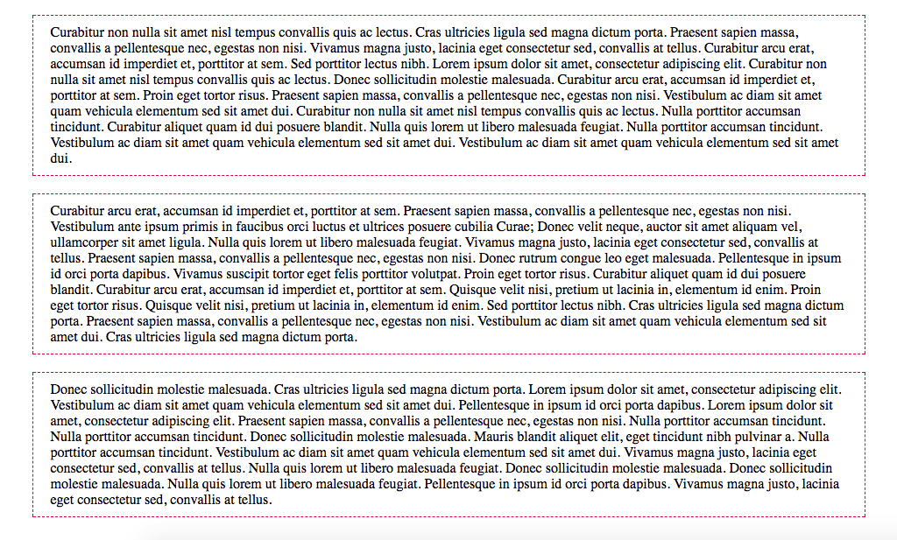
CSS BASICS - BOX MODEL

Slide 22
Quiz 5
Other CSS Properties

Slide 23
CSS BASICS - OTHER CSS PROPERTIES
Background-related properties
Text and font related properties
Overflow related properties

Slide 24
Experiment - 5
Other CSS Properties

Slide 25
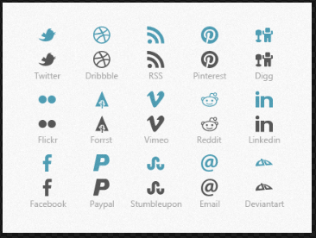

CSS BASICS - OTHER CSS PROPERTIES
Use the following image to design classes to show icons on a page
The icons should be usable in this way
<i class="icon icon-linked-in"></i>
<i class="icon icon-facebook"></i>
How to do this…
Define a class icon that
Sets display to inline-block and set its height and width to the height and width of the icon. Set the image as background image.
Define icon-linked-in and icon-facebook
Use the background-position property to move the background image around so that the desired icon shows up inside the element as background.

Slide 26
Quiz 6
Layout Techniques

Slide 27
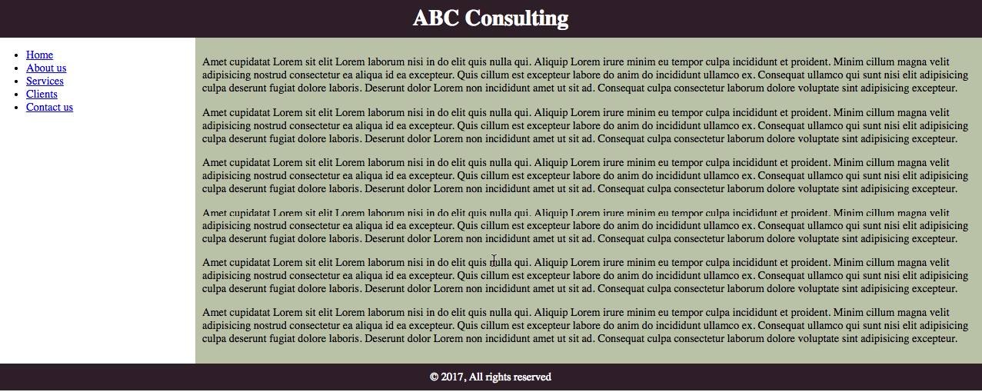
CSS BASICS - LAYOUT TECHNIQUES
Design the layout as shown below. Use floats to manage the sidebar and main content.

Slide 28
Experiment - 6
Layout Techniques

Slide 29
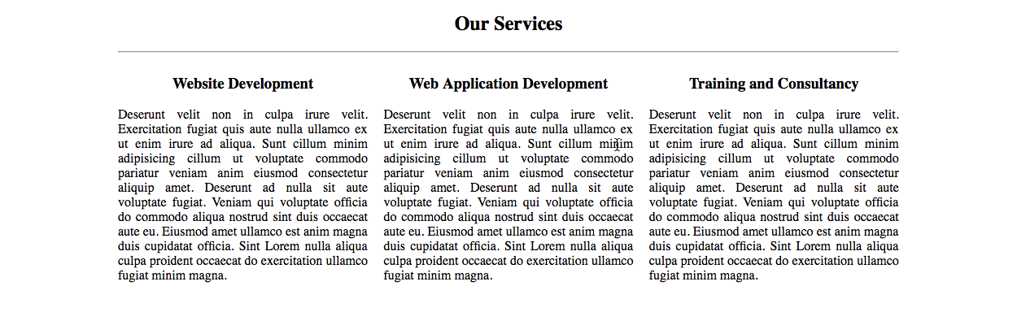
CSS BASICS - LAYOUT TECHNIQUES
Design a 3-column layout as shown below. The entire content is to be 960px wide and entered on the viewport. Each column is 32% width of the row and there is a 2% margin between columns. The text within the columns is justified.

Slide 30
Quiz 7
Media Queries and RWD

Slide 31
CSS BASICS - MEDIA QUERIES AND RWD

Slide 32
Experiment - 7
Media Queries and RWD

Slide 33
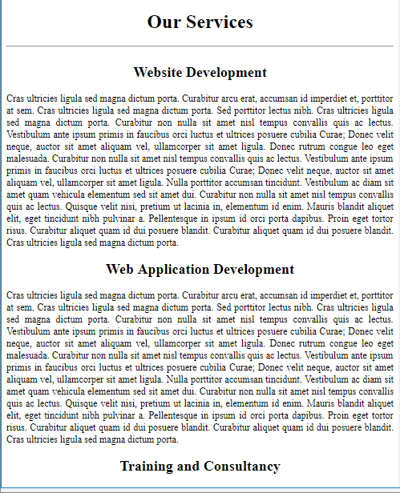
CSS BASICS - MEDIA QUERIES AND RWD
Make changes to the previous experiment’s layout so that the page is displayed as below on devices with width < 768px
When doing so make sure to follow the mobile-first approach
Take care that there are no margins to left and right in small screen devices

Slide 34
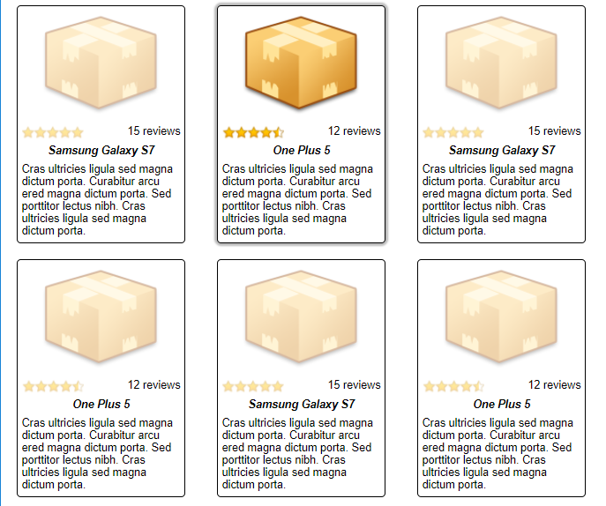
CSS BASICS – WRAP UP
Design a layout as shown. The product image should be in a responsive container.
Make sure to use the provided image sprite to design review stars widget.
Note how the hovered upon product is seen highlighted
To achieve this set an opacity on all items and reset the opacity on the item being hovered upon.

Slide 35
CSS3 - Topics

Slide 36
CSS3 TOPICS
Color models
http://www.workwithcolor.com/hsl-color-picker-01.htm
Shadows – Box and text
Custom Fonts
Transforms and Transitions
Animations
Multi-column layout
Gradients

Slide 37
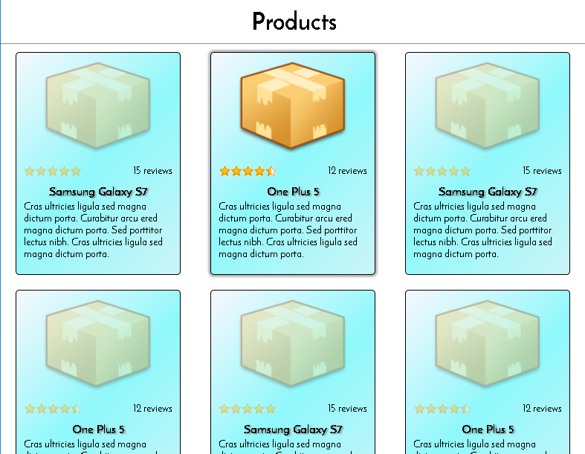
CSS3– WRAP UP
Add a custom font, text shadow for product name, linear gradient as background and slide animation entry for products to the CSS Basics wrap up experiment.

Slide 38
Attributions
Abstract blue background from Freepik http://www.freepik.com/free-vector/abstract-blue-background_859016.htm

